Slide 1
Home Credit Score Card Model
Cecilia Tania Emanuella
cecil.my.id
Rakamin Batch May
Data Scientist Virtual Internship Program Home Credit Indonesia

Slide 2
Identifying the Business Problem
Home Credit is currently using various statistical methods and Machine Learning to make credit score predictions. Based on the submitted credit loan application data, 10 prediction models were made with a classification algorithm and then compared them to obtain the best predictive model in determining whether the loan application was accepted or not.
The dataset used is application_train.csv
10 Machine Learning Models used are Random Forest Classifier, Support Vector Classifier (SVC), Logistic Regression, Decision Tree Classifier, KNeighbors Classifier, Gradient Boosting Classifier, AdaBoost Classifier, XGBoost Classifier, CatBoost Classifier, and ExtraTrees Classifier.
For more details, you can see Jupyter Notebook here

Slide 3
Data Exploration and Data Pre-Processing
Display the data
Information of the data
Checking for missing values and there are many missing values
Delete columns containing missing values
Delete a column whose contents are all zero
Create an Age column with the formula: (DAYS_REGISTRATION-DAYS_BIRTH)/365
Check for duplicate data, no duplicate data
Delete the unnecessary columns: SK_ID_CURR, DAYS_BIRTH, DAYS_EMPLOYED, DAYS_REGISTRATION, DAYS_ID_PUBLISH, WEEKDAY_APPR_PROCESS_START, and HOUR_APPR_PROCESS_START.
Converting categorical data to binary

Slide 4
Data Exploration and Data Pre-Processing
Overcome columns with outliers, namely: CNT_CHILDREN, AMT_INCOME_TOTAL, AMT_CREDIT, AMT_ANNUITY, AMT_GOODS_PRICE, REGION_POPULATION_RELATIVE, OWN_CAR_AGE, CNT_FAM_MEMBERS, and EXT_SOURCE_2
Divide the dataset into 80% training data and 20% testing data
Normalize numeric data with MinMaxScaler()
Oversampling (SMOTE) for label balancing
Reduce overfitting by using PCA

Slide 5
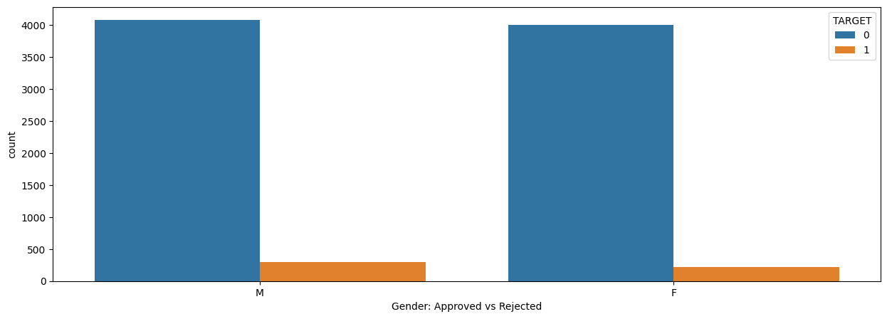
Data Visualization & Business Insight
Most of the customers who received and rejected loans were male.

Slide 6
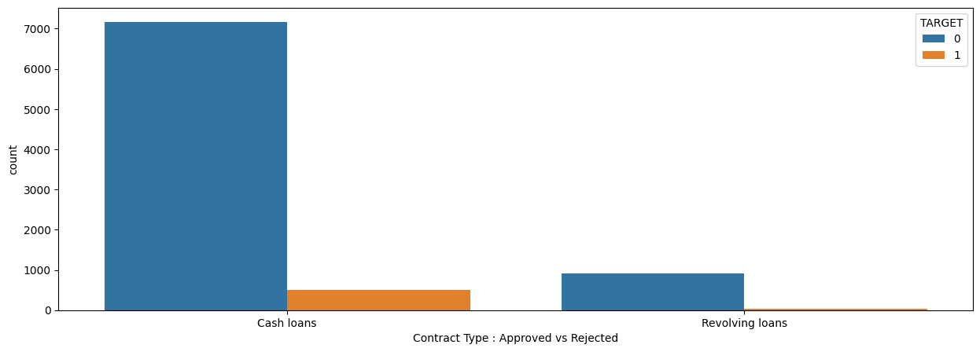
Data Visualization & Business Insight
The type of loan contract that is more widely accepted and rejected is Cash Loans

Slide 7
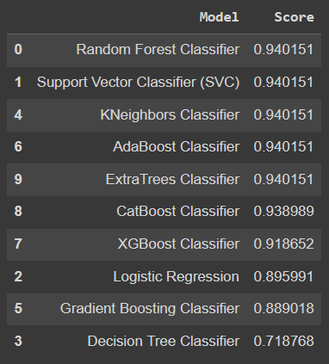
Machine Learning Implementation
There are 12 ML models using hyperparameter tuning

Slide 8
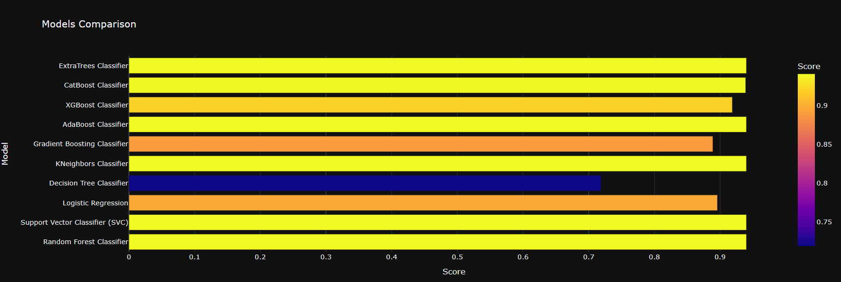
Machine Learning Evaluation
The model with the best accuracy is the Random Forest Classifier with an accuracy of 94.01%

Slide 9
Business Recommendation
The type of loan contract that is more widely accepted is Cash Loans, so it is necessary to increase the reserve of loan funds large enough to be able to accommodate the approved Cash Loans.
Fewer types of Revolving Loans are accepted, so it is necessary to improve marketing strategies related to Revolving Loans products.
The type of loan contract that is rejected the most is Cash Loans, therefore it is necessary to review the investigation process of prospective customers, for this reason, they can use the Random Forest Classifier machine learning model with an accuracy of 94.01%

